Slide 1

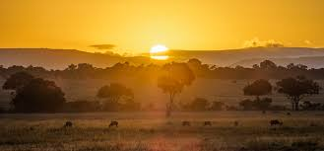

Summer Camp 2026: Kenya

Slide 2
Agenda
Intro/Background
The Expedition
Money and Fundraising
Prepare for travel
Next Steps
Questions

Slide 3
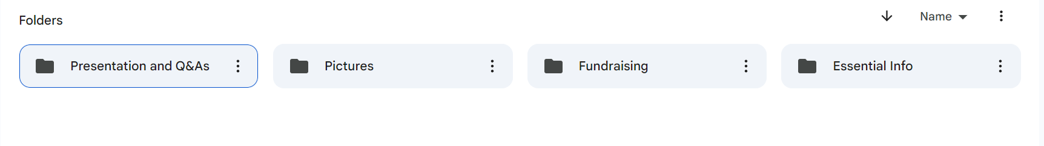
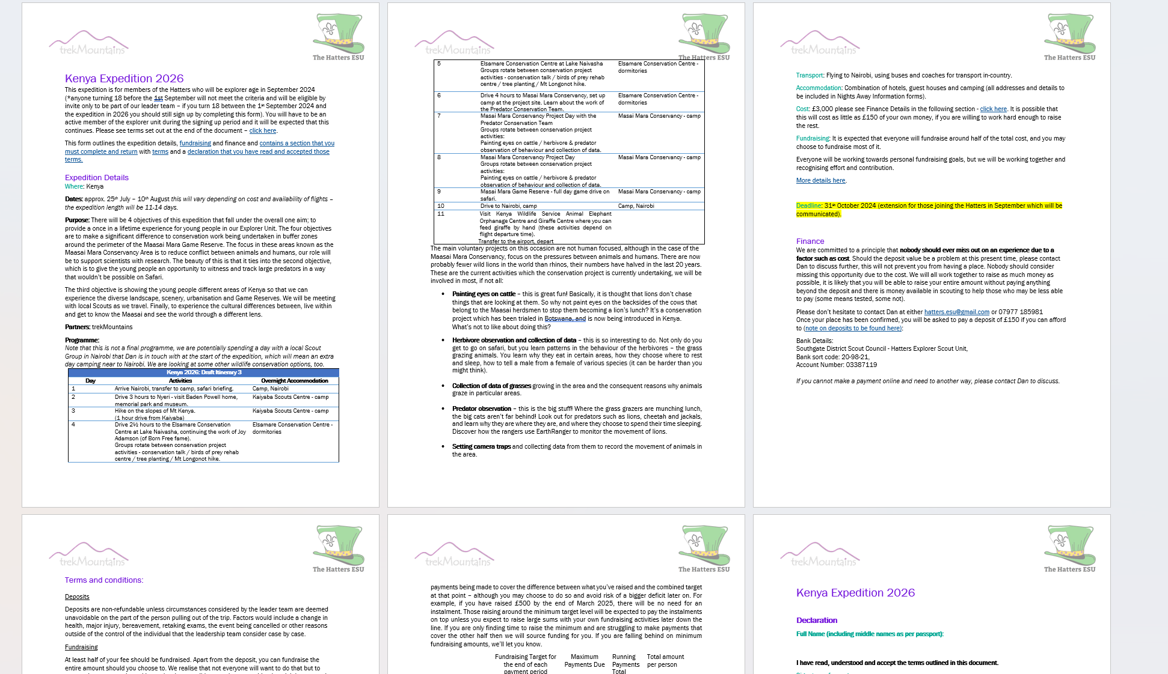
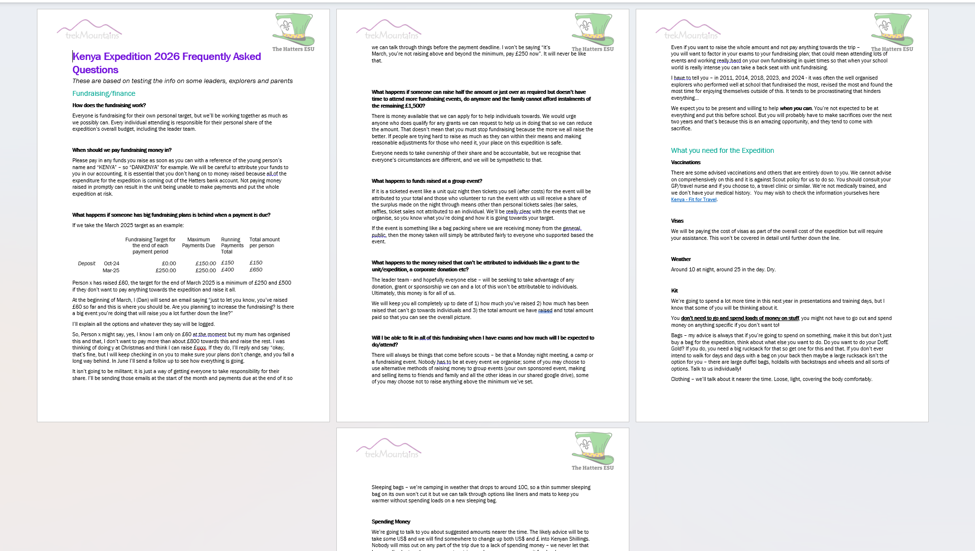
EVERYONE WHO SIGNS UP WILL BE GIVEN ACCESS TO THE FOLDERS WITH FUNDRAISING INFO. THE DETAILS ATTACHED TO THE EMAIL WILL ALSO BE AVIALALBE.
Read the Ts and Cs doc and the FAQs doc! The Ts and Cs must be signed and returned to join the expedition.

Slide 4
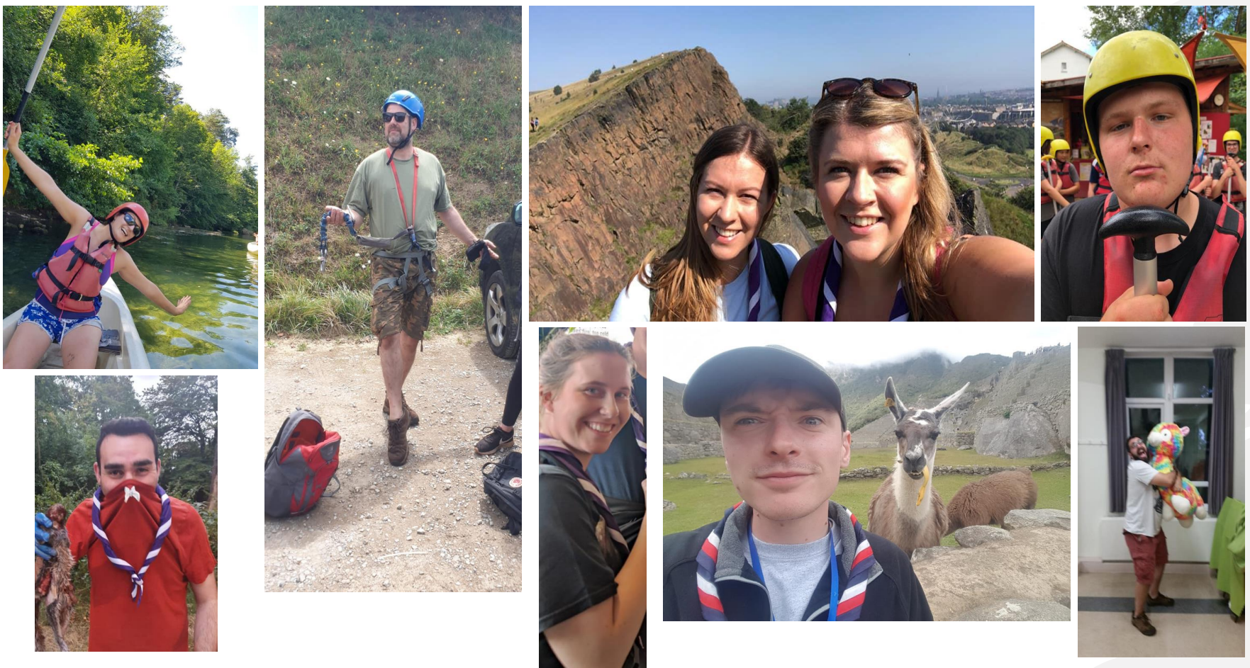
The Expedition Leader Team will include the Monday night team, Ann and Steve from trekMountains plus others

Slide 5
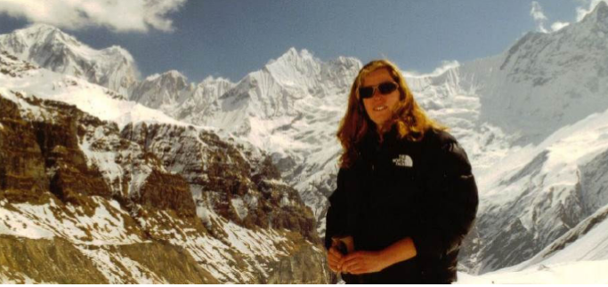
Ann delivers expeditions to amazing parts of the world year-round for private clients, schools and youth groups. We have worked with Ann successfully in India and Morocco.
Welcome to trekMountains | trekMountains - https://www.trekmountains.com/

Slide 6
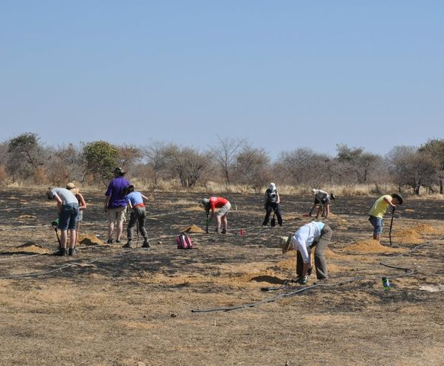
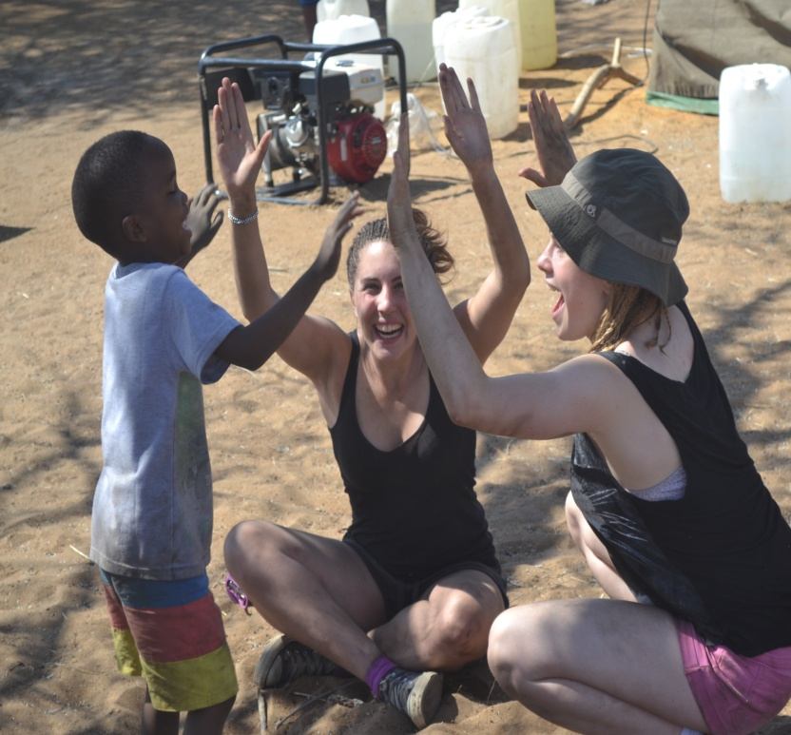
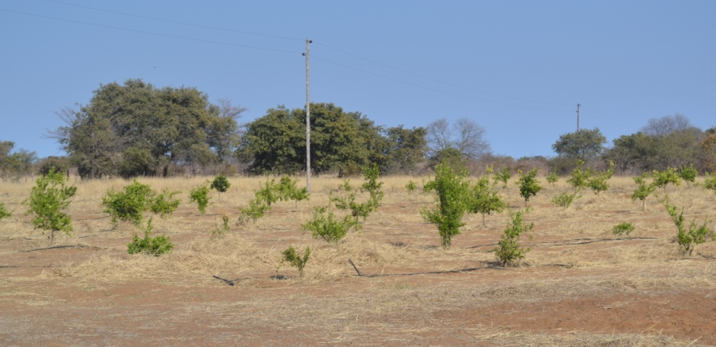
Background Namibia
Peru
India
Morocco
It isn’t our first rodeo. Trust us!

Slide 7
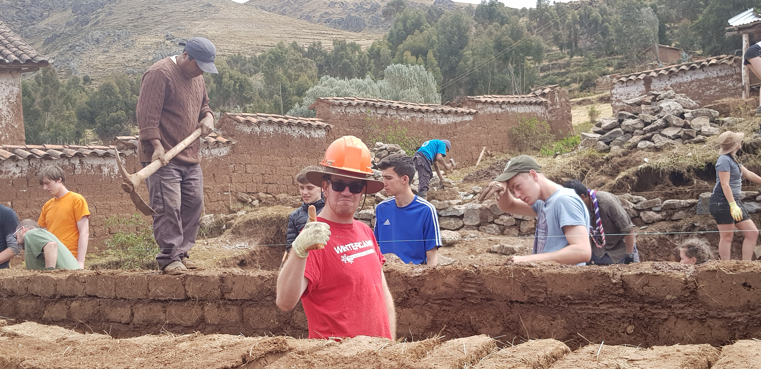
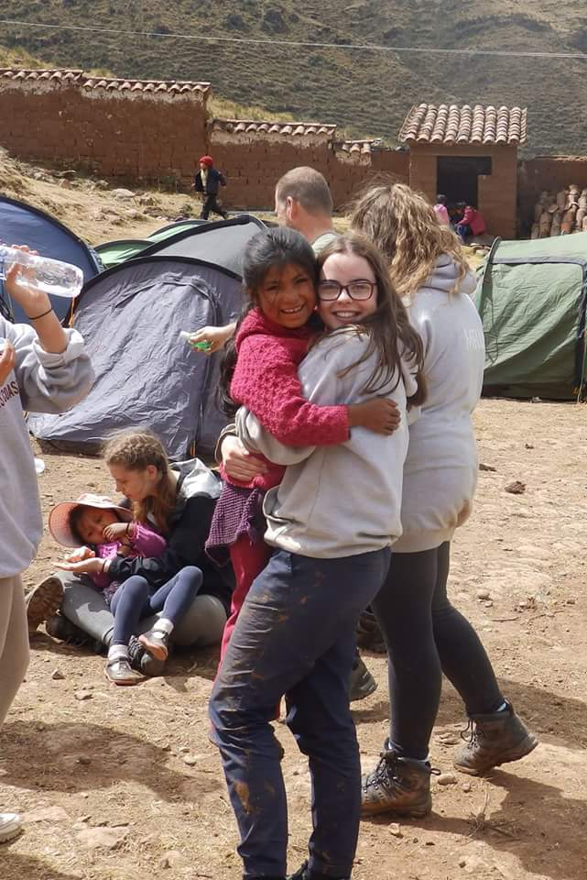
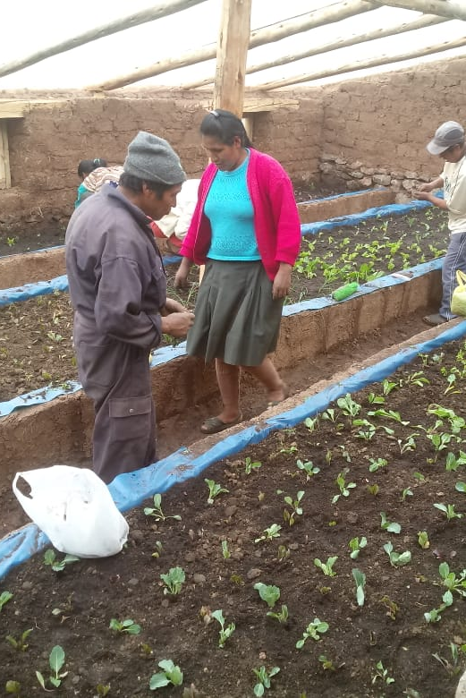
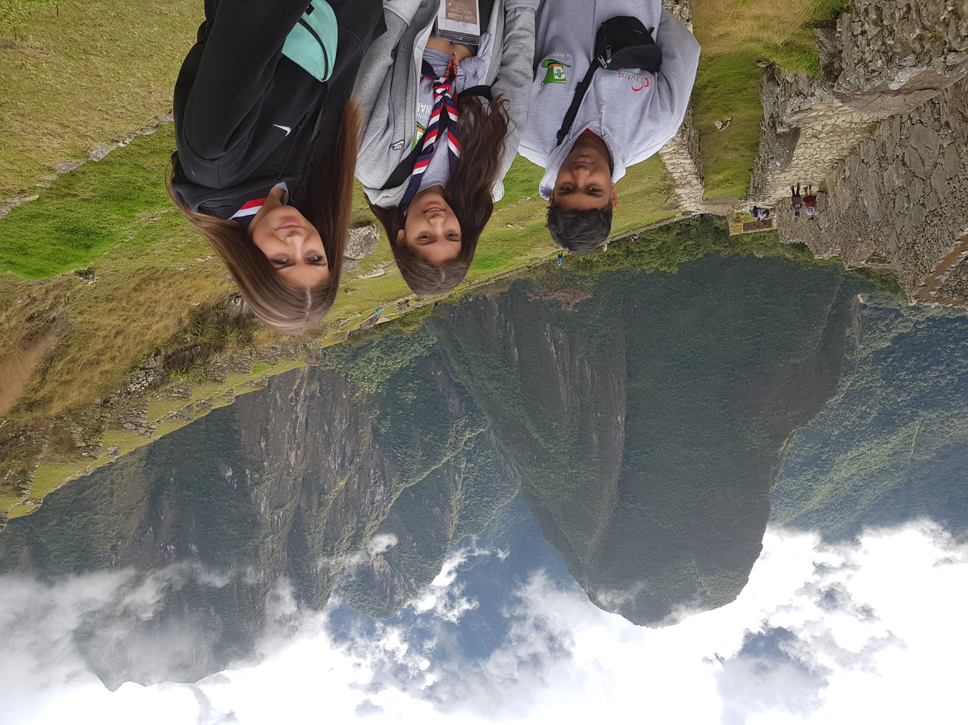
2018 Expedition to Peru

Slide 8
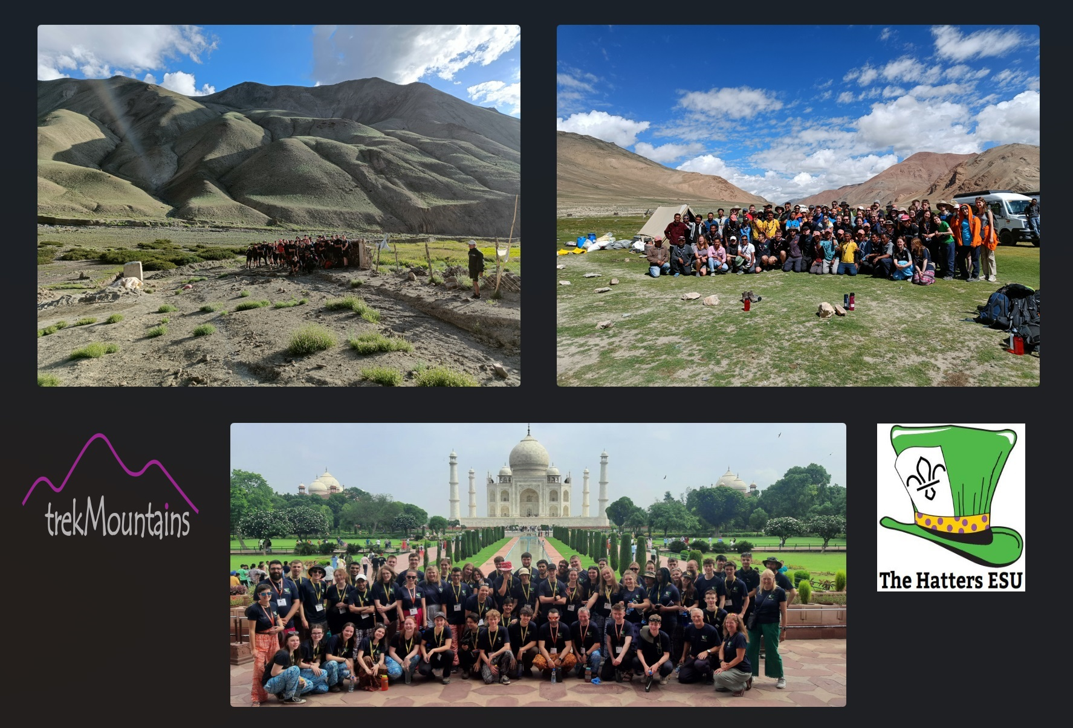
2023 Expedition to India

Slide 9
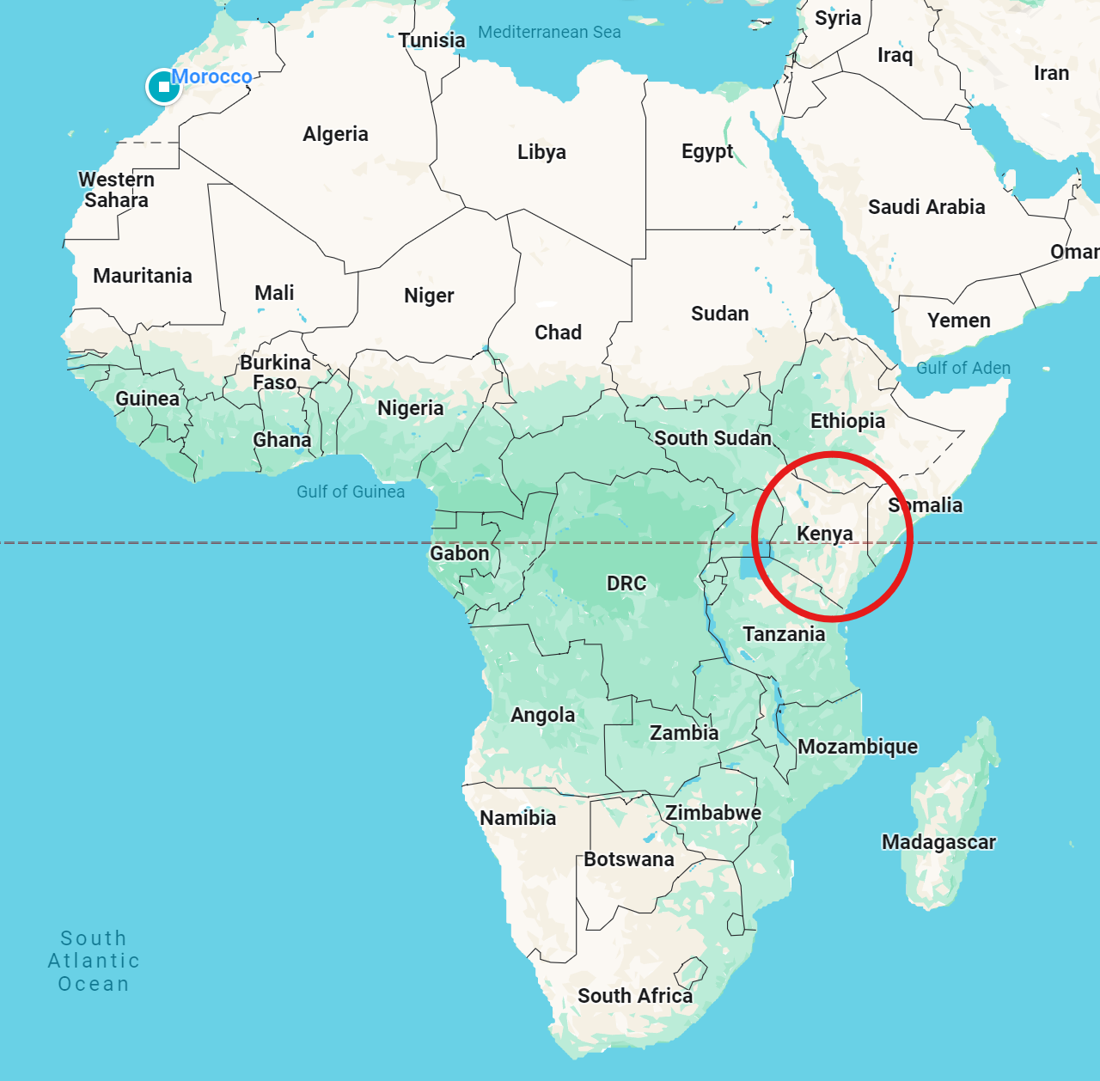
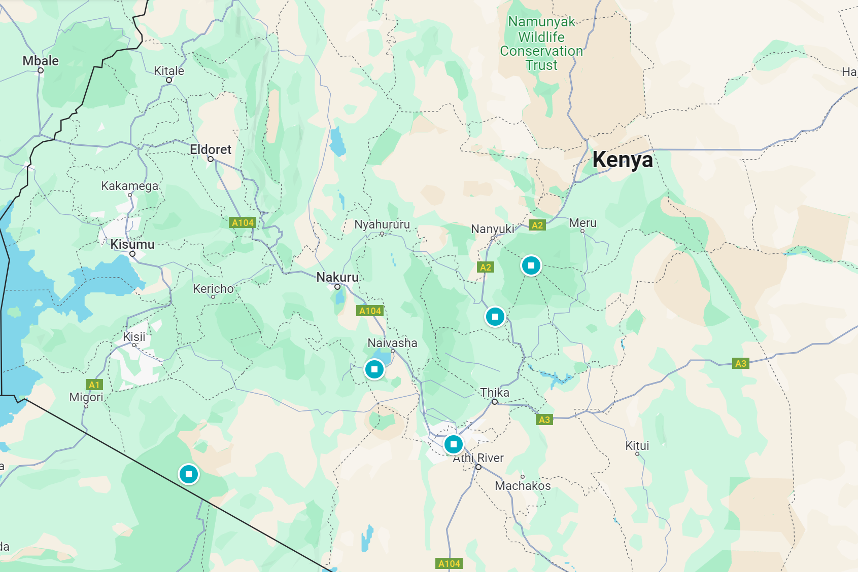

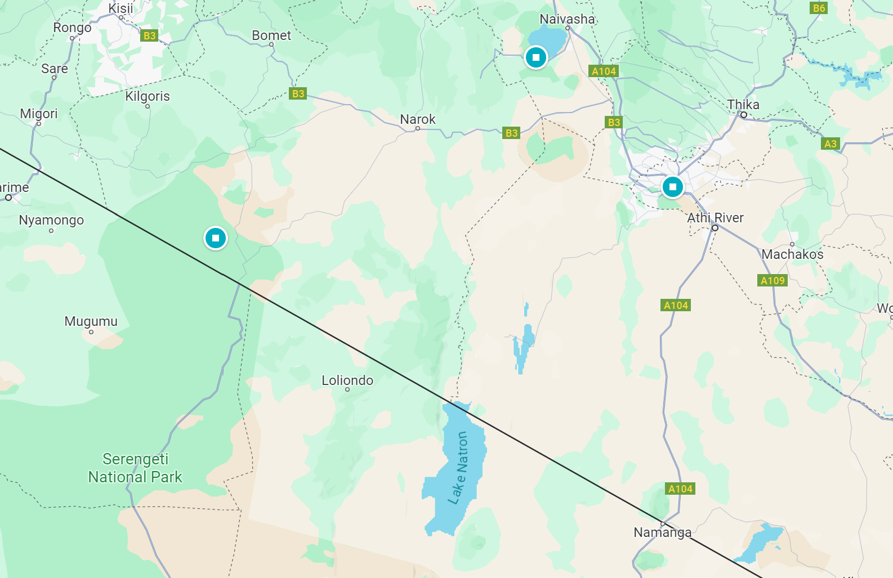
Kenya Expedition 2026
https://maps.app.goo.gl/T5fFZ7TZGvy7r9kSA

Slide 10
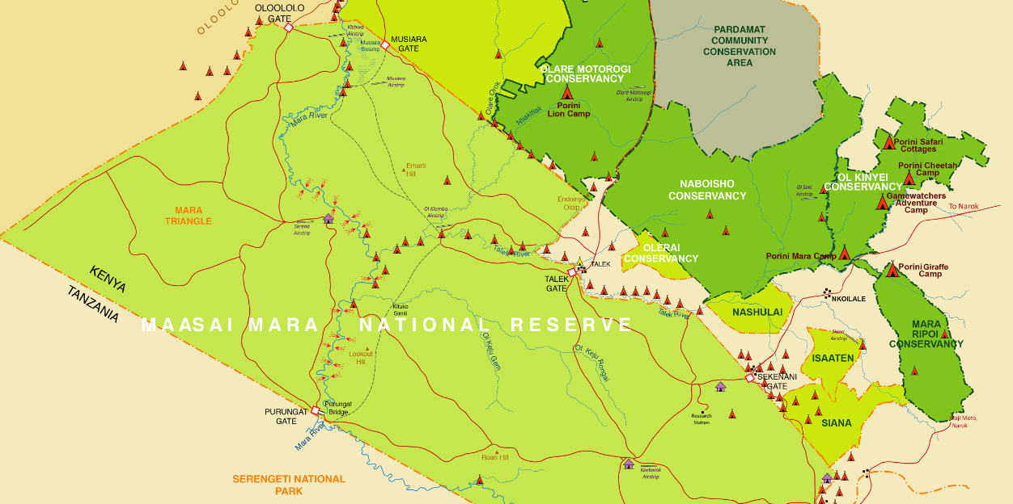
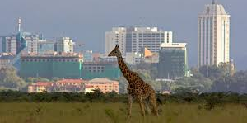
Programme (some areas to be confirmed)
Kenya National Scout Centre
Mt Kenya Hike
Elsamare Conservation Centre
Massai Mara Game Reserve
Predator Conservation in Maasia Mara Conservancy
Safari
Beach
Nairobi
Elephant and giraffe orphanages

Slide 11
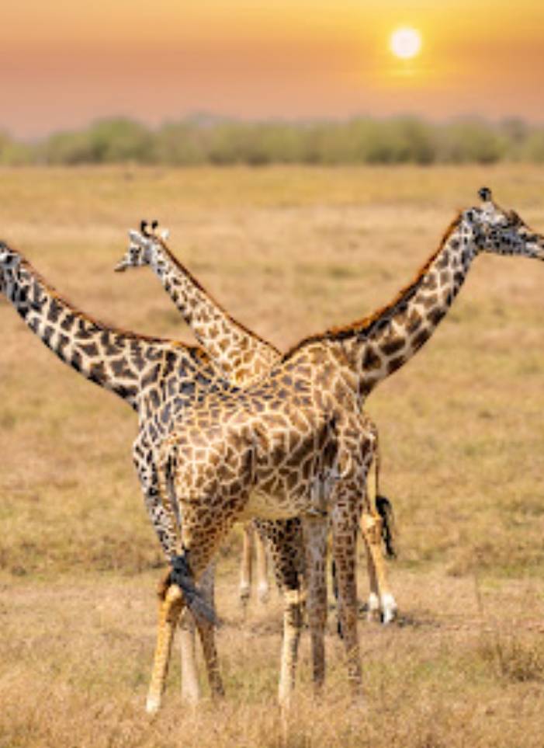
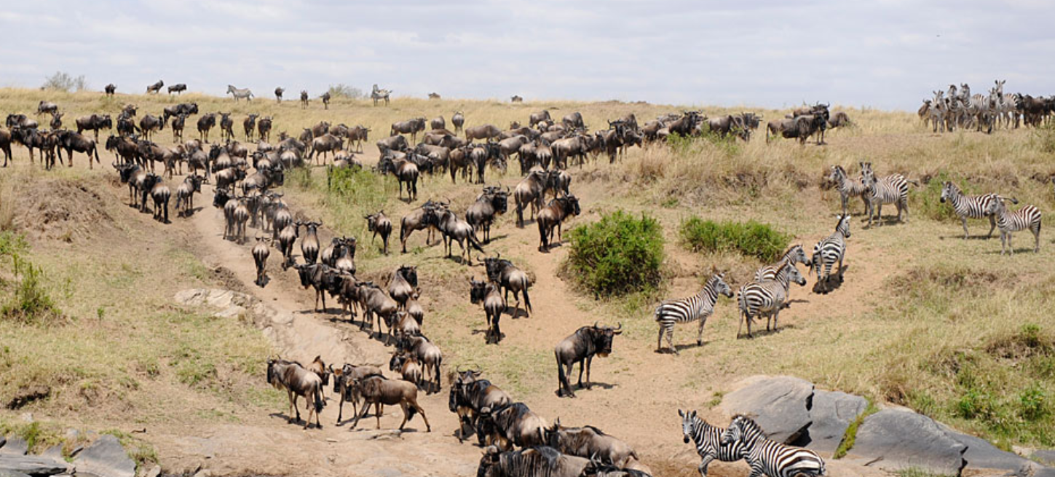
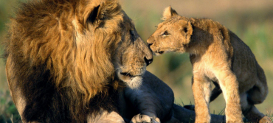

Slide 12
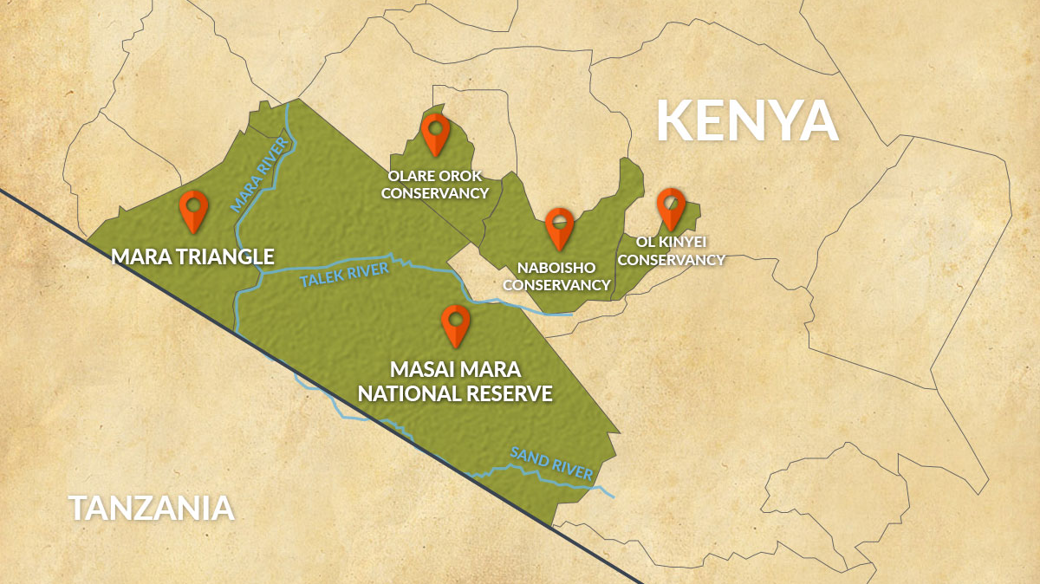

Slide 13
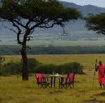
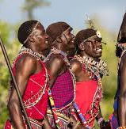
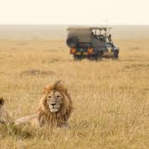

Volunteering in the Maasai Mara Conservancy
Big predators
Camera traps
Painting eyed on cattle
Herbivore observation
Notes:
• Painting eyes on cattle – this should be hilarious and cause some risk assessment challenges! Basically, it is thought that lions don’t chase things that are looking at them. So why not paint eyes on the rump of the cows that belong to the Maasai herdsmen to stop them becoming a lion’s lunch? It’s a conservation project which has been tried in Botswana and is now being introduced in Kenya. What’s not to like about doing this?
• Herbivore observation and collection of data – this is so interesting to do. Not only do you get to go on safari, but you learn patterns in the behaviour of the herbivores – the grass grazing animals. You learn why they eat in certain areas, how they choose where to rest and sleep, how to tell a male from a female of various species (it can be harder than you might think).
• Predator observation – this is the big stuff! Where the grass grazers are munching lunch, the big cats aren’t far behind! Look out for predators such as lions, cheetah and jackals, and learn why they are where they are, and where they choose to spend their time sleeping. Discover how the rangers use EarthRanger to monitor the movement of lions.
• Setting camera traps and collecting data from them to record the movement of animals in the area.
• Collection of data of grasses growing in the area and the consequent reasons why animals graze in particular areas.

Slide 14
Voluntary Projects with the Maasai
1. Painting eyes on cattle – this should be hilarious and cause some risk assessment challenges! Basically, it is thought that lions don’t chase things that are looking at them. So why not paint eyes on the rump of the cows that belong to the Maasai herdsmen to stop them becoming a lion’s lunch? It’s a conservation project which has been tried in Botswana and is now being introduced in Kenya. What’s not to like about doing this?
2. Herbivore observation and collection of data – this is so interesting to do. Not only do you get to go on safari, but you learn patterns in the behaviour of the herbivores – the grass grazing animals. You learn why they eat in certain areas, how they choose where to rest and sleep, how to tell a male from a female of various species (it can be harder than you might think).
3. Predator observation – this is the big stuff! Where the grass grazers are munching lunch, the big cats aren’t far behind! Look out for predators such as lions, cheetah and jackals, and learn why they are where they are, and where they choose to spend their time sleeping. Discover how the rangers use EarthRanger to monitor the movement of lions.
4. Setting camera traps and collecting data from them to record the movement of animals in the area.
5. Collection of data of grasses growing in the area and the consequent reasons why animals graze in particular areas.

Slide 15
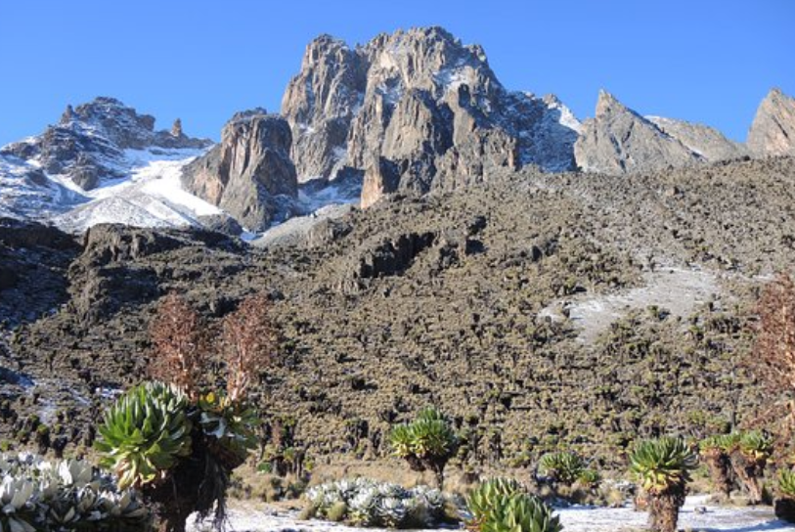
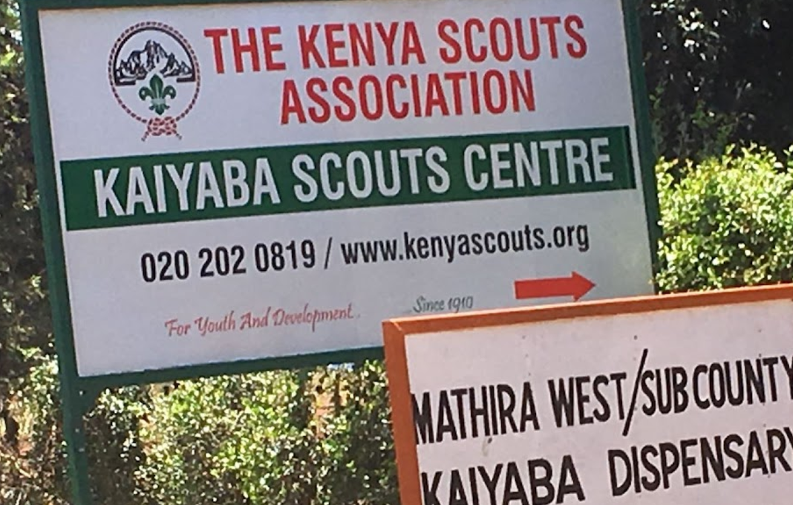
• Wildlife conservation – the centre offers a lecture on this topic
• Visit birds of prey rehabilitation centre
• Tree planting
• Visit Joy Adamson Museum

Slide 16

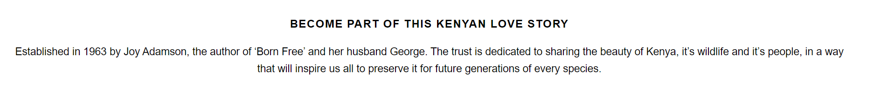
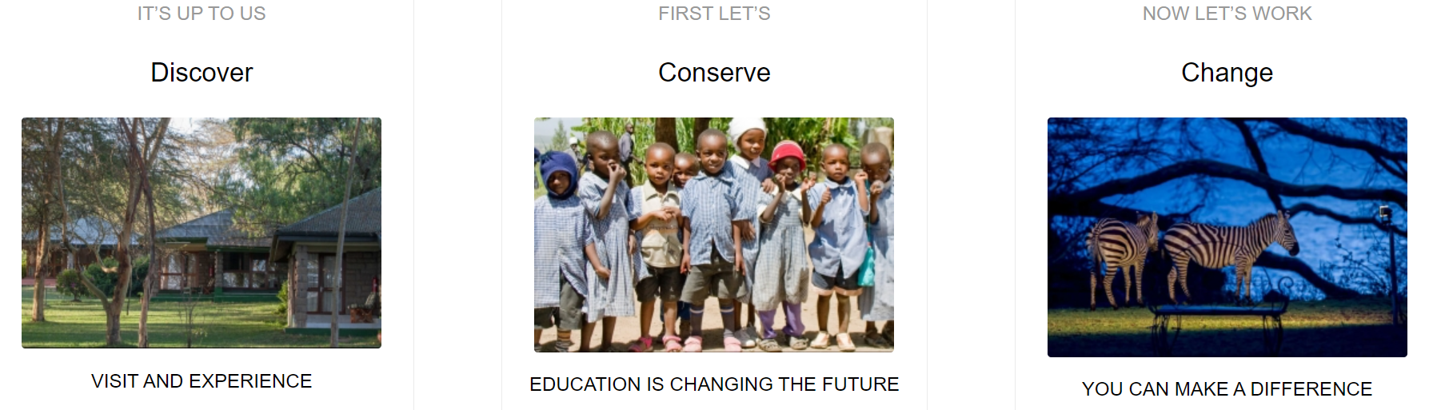

Slide 17

Fundraising

Slide 18
Fundraising – how?
We will raise funds as a group, and we will give you the resources that you need to raise funds alone. For those in need, we will help you to apply for additional funding and provide some where possible.
Support group events
Organise events
Sell tickets to events
Volunteer
Apply for funding individually
Gather sponsorship
Crowd fund
Arrange fundraising with schools/colleges/universities
Write to businesses
Work/babysit etc.
Sell items online (and reach out to friends, neighbours and family to ask for items):
  Etsy
  eBay
  Vinted

Slide 19
Fundraising – why?
Fundraising is an important part of an experience like this, each person is signing up to fundraise at least 50% of their total fee. You will have a more complete and worthwhile adventure if you have earned it for yourself.
This may seem like a lot now, but it is possible! We will be organising at least 1 event a month that you can sell tickets for, bring people along and help run all to hit your targets.

Slide 20



Finances
The cost of the expedition is up to £3000
This can be made up of money paid by or money earned through fundraising
We won’t let anyone miss out because of money – there is plenty of money available to support anyone who is willing to work
Everyone will receive regular updates so that you know exactly where you are up to with your fundraising and payments

Slide 21
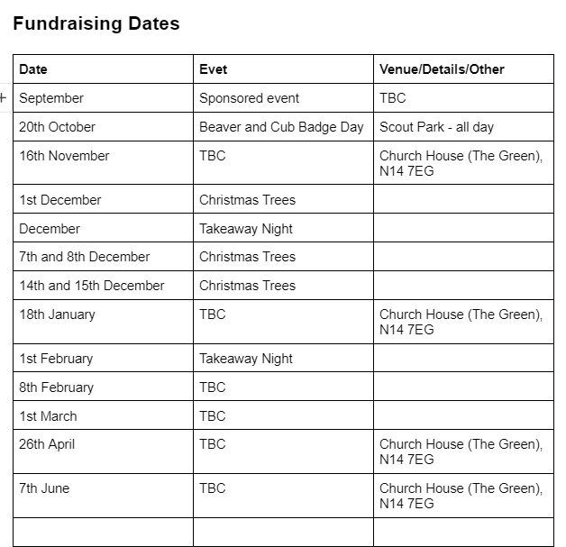
Review these files and find fundraising information here - https://drive.google.com/drive/folders/1aC_9ufGii3z4TXiGSbKCcgOfohoGTy9Q?usp=drive_link

Slide 22
Grants and financial assistance
Young Explorers’ Trust Numerous awards aimed at overseas expeditions for young people https://www.theyet.org/what-we-do/grant-awards/#guide-to-awards
Timmissarktok Foundation “Grants for Exploration” http://www.timmissartok.com/
The RDC Foundation http://www.rdc.foundation/
Alpkit https://alpkit.com/pages/foundation
Cam and Bear Fund https://www.camandbearfund.com/apply
Vivian Fuchs Youth Award http://www.captainscottsociety.com/awards.html
SOME grants to support members in financial hardship to take part in international events

Slide 23
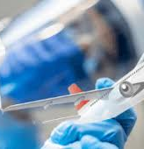
Fit for travel
Book at early appointment with a travel nurse
Vaccinations; personal process, not one-size
Speak to us if you want to
Don’t leave anything too late
Water purification tablets and rehydration salts

Slide 24
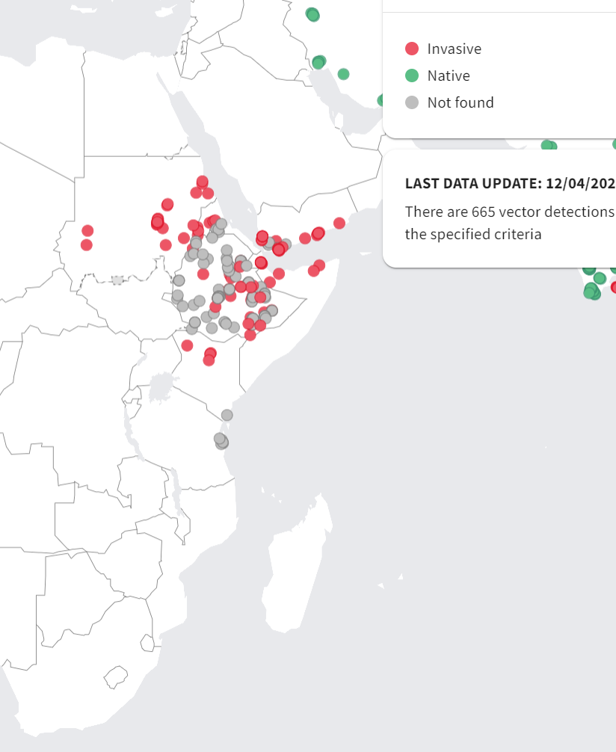
Confirm primary courses and boosters are up to date as recommended for life in Britain - including for example, seasonal flu vaccine (if indicated), MMR, vaccines required for occupational risk of exposure, lifestyle risks and underlying medical conditions.
Courses or boosters usually advised: Diphtheria; Hepatitis A; Poliomyelitis; Tetanus.
Other vaccines to consider: Hepatitis B; Meningococcal Meningitis; Rabies; Typhoid; Yellow Fever.
Selectively advised vaccines - only for those individuals at highest risk: Cholera.
Yellow fever vaccination certificate required for travellers aged 1 year or over arriving from countries with risk of yellow fever transmission.
Notes:
Temperatures – not usually too hot in August, but hot enough to prepare for extremes. Not usually very low at night. Record low is 4C overnight, usually warm enough for a 2-season sleeping bag to be sufficient.
Known risks – current political situation. Tensions with neighbours. Backup plans.

Slide 25
What next?
Book your place!
Deadline of October
Your say
Parent Meetings/Q&As
Fundraising starts in September
Passports & Fit for Travel

Slide 26


